Slide 1

PROJECT ON: OBJECT FOLLOWER ROBOT WITH ARDUINO AND PIXY2 SUBMITTED TO: Prof. Nashwan J Sebi
WINTER 2023 ECE 5415
MICROCOMPUTER BASED CONTROL SYSTEMS
School of Engineering and Computer Science
SUBMITTED BY: SUBMITTED ON : 3/12/2023
GROUP J
UNNIMAYA KARUTHEDATH
Niranjan Chennasamudram Balaji

Slide 2
CONTENTS
INTRODUCTION
VISION SENSORS
HARDWARE
SOFTWARE
DEMO
OBSERVATIONS

Slide 3
introduction
An object follower robot is a type of robot that is capable of tracking and following an object in real-time.
sensors detect the object, and motors or other mechanical components to move towards the object and maintain a specific distance or orientation.
software algorithms to process and interpret the sensor data and control the robot's movements.
industrial automation and material handling to surveillance and security.

Slide 4
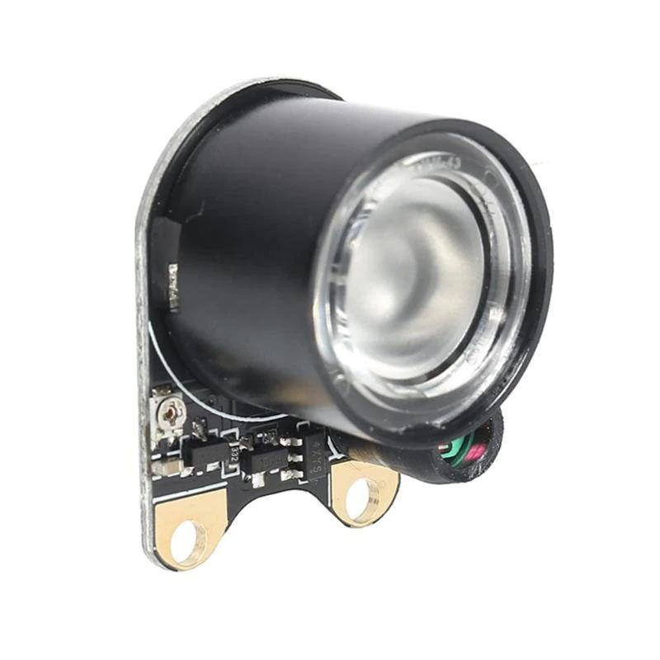
Vision sensors
Various types of sensors can be used for object tracking :
Infrared (IR) sensors , Ultrasonic sensors , LIDAR (Light Detection and Ranging) sensors , Vision sensors (cameras).
Why vision sensors?
Cameras can provide a rich source of visual data
more accurate tracking and identification of objects
detect multiple objects simultaneously
can adapt to changing lighting conditions or environments.

Slide 5
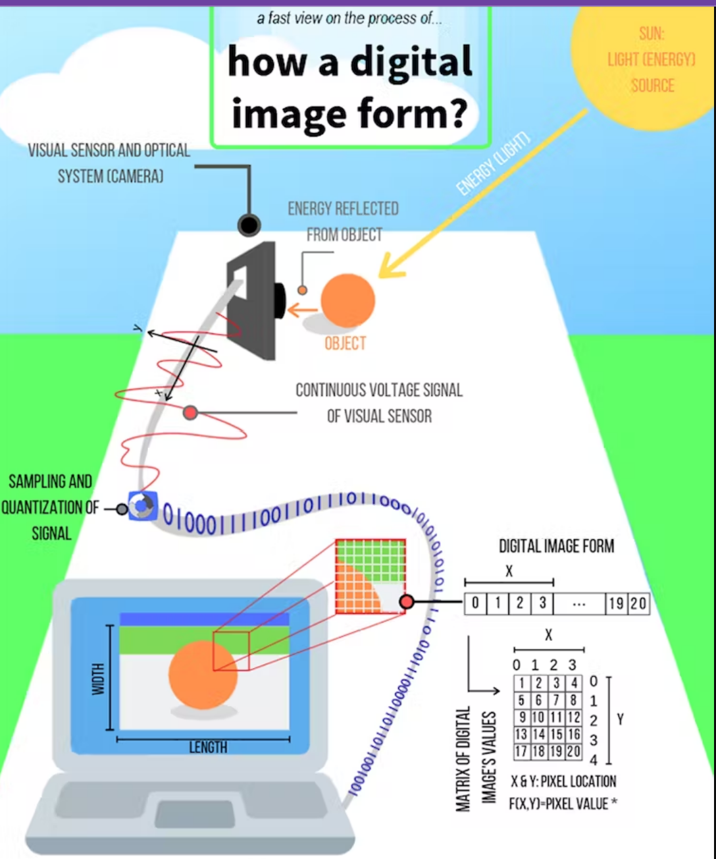
Digital image
Every image is a signal with pixel values indicating each point of the image
Pixel is the basic unit of a digital image that can have different values for its brightness/ &/color , called intensity.
The signal is the continuous voltage signal given by visual sensor
This signal will be converted to digital form with some processes like sampling
The digital form of these data is like a two-dimensional array or matrix make a digital image so their form is f (X, Y) for the location and value.

Slide 6
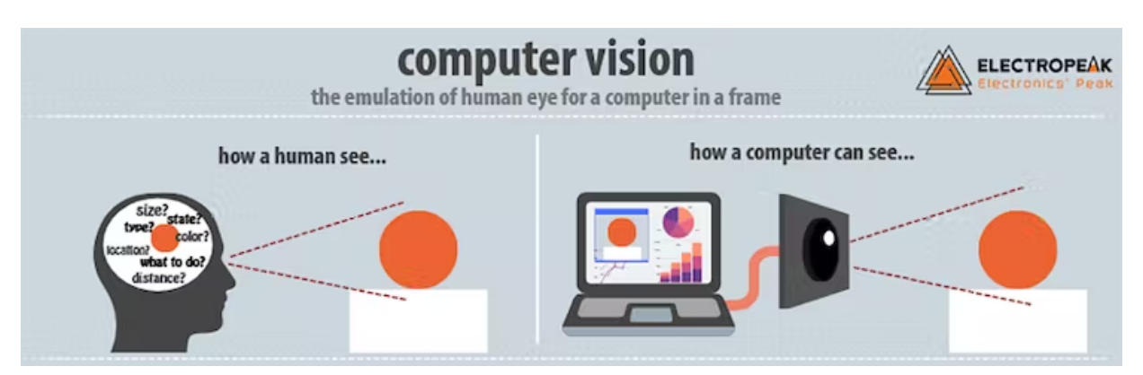
Computer vision
Afield of artificial intelligence that trains computers to interpret and understand the visual world.
Acquiring, processing, analyzing and understanding digital images, deal with the extraction of high-dimensional data from the real world in order to produce numerical or symbolic information in the form of decisions

Slide 7

hardware
PIXY 2
ARDUINO
CAR CHASSIS

Slide 8

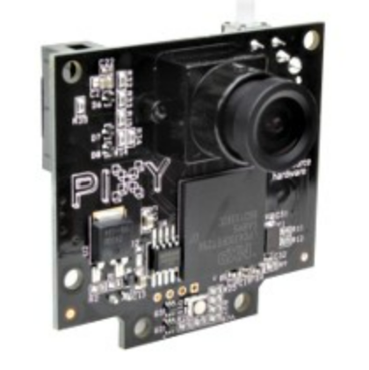
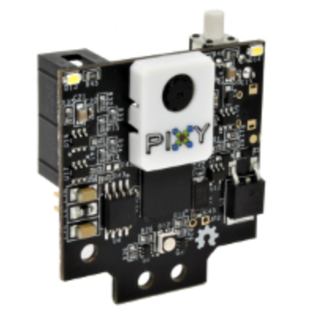

Pixy 2
Small, fast, easy-to-use, low-cost, readily-available vision system
Learns to detect objects that you teach it : Remembers up to 7 distinct color signatures
Improved framerate – 60 frames-per-second
C/C and Python are supported
Communicates via one of several interfaces: SPI, I2C, UART, USB or analog/digital output
Integrated light source
Tracking algorithms in addition to color-based object detection
Pixy2 has new algorithms that detect and track lines for use with line-following robots.
Pixy2 can be used to do lane keeping.
The new algorithms can detect intersections and “road signs” as well.
The road signs can tell your robot what to do, such as turn left, turn right, slow down, etc.
Pixy2 can detect and decode ColorCodes and present them as special objects

Slide 9
OBJECT DETECTION USING PIXY2
Pixy2 uses a color-based filtering algorithm to detect objects called the Color Connected Components (CCC) algorithm.
Color-based filtering : Fast, efficient, and relatively robust
Primary filtering parameters - Color (hue) and saturation of each RGB pixel
Hue of an object remains largely unchanged with changes in lighting -> Pixy2’s filtering algorithm is robust when it comes to lighting and exposure changes.
Pixy2's CCC algorithm remembers up to 7 different color signatures
Once Pixy2 detects a new object, it will add it to a table of objects that it is currently tracking and assign it a tracking index.
We had difficulties with lighting and exposure changes

Slide 10
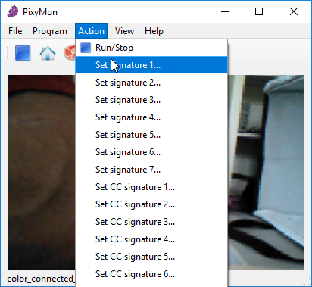
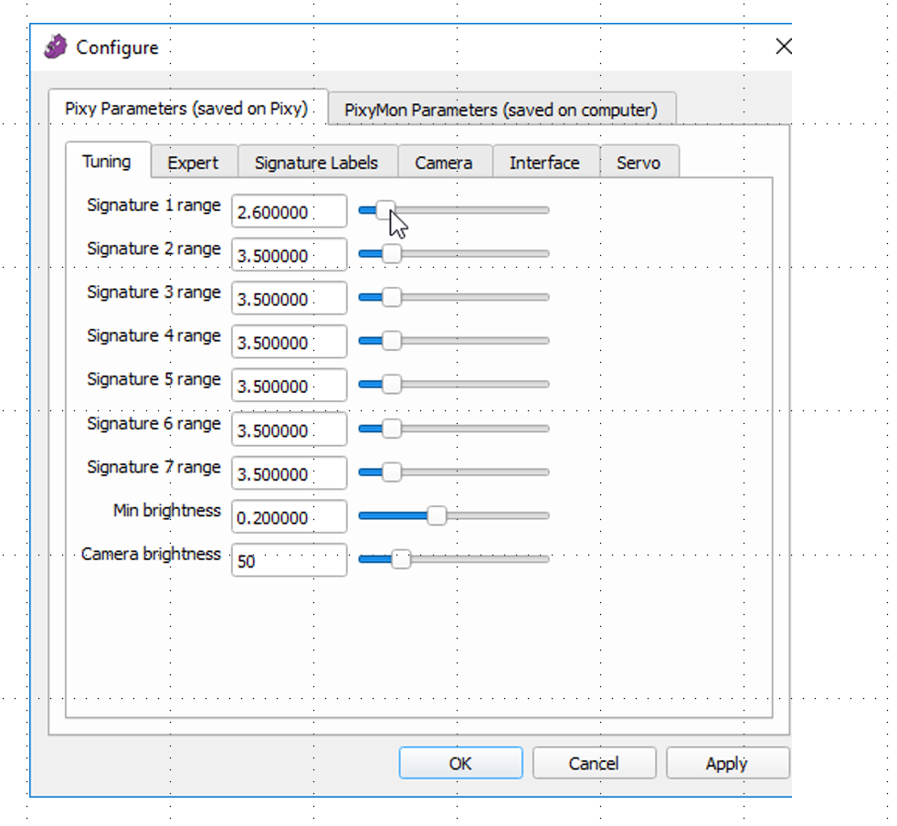
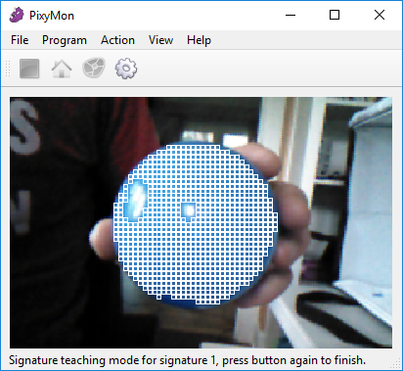
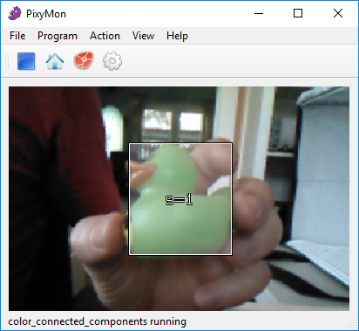
Teaching pixy an object
Teaching can be done manually , or using pixymon
Proper signature tuning must be done to avoid false positives and negatives

Slide 11
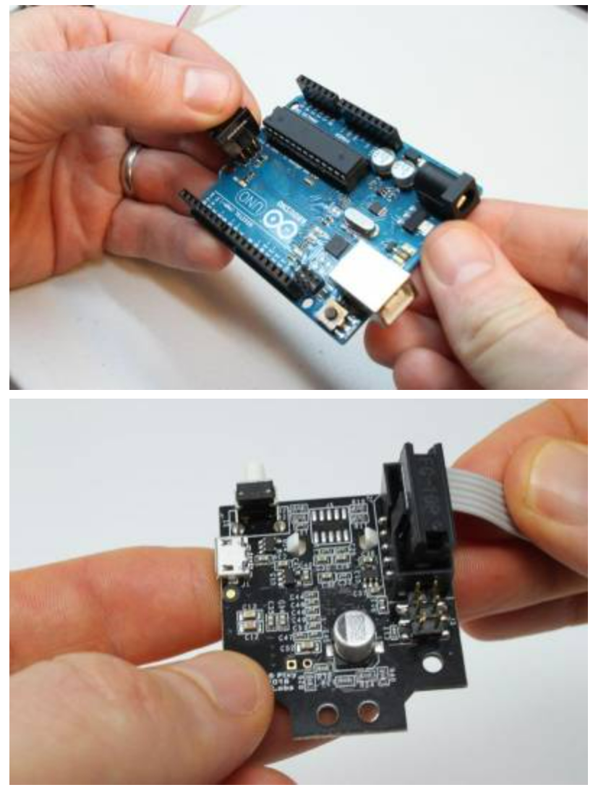
Connecting pixy 2 to arduino
The pixy 2comes with a cable that can be used to connect it to Arduino
Communication speed : 1 Mbits/second -> 6000 detected objects per second or 100 detected objects per frame
Once the object is detected Arduino controls the pwm so that motors can be made to move left/right or go straight , to follow it.

Slide 12
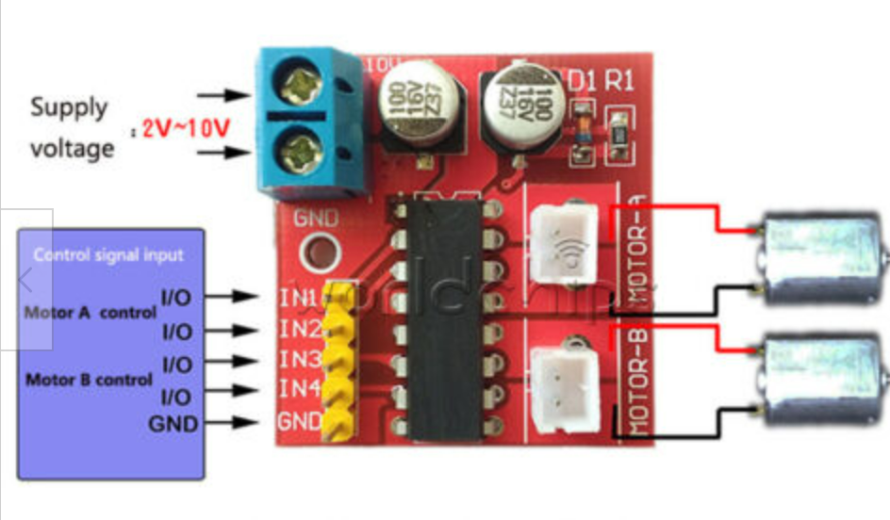
CAR chassis
Car chassis with 4 DC motors and an L298N Motor Drive Controller
Two standard H-bridges capable of driving a pair of DC motors, making it ideal for building a two-wheeled robotic platform.
The module has two direction control pins. The IN1 and IN2 pins control the spinning direction of motors on the left and IN3 and IN4 control the spinning direction of motors on the right.

Slide 13
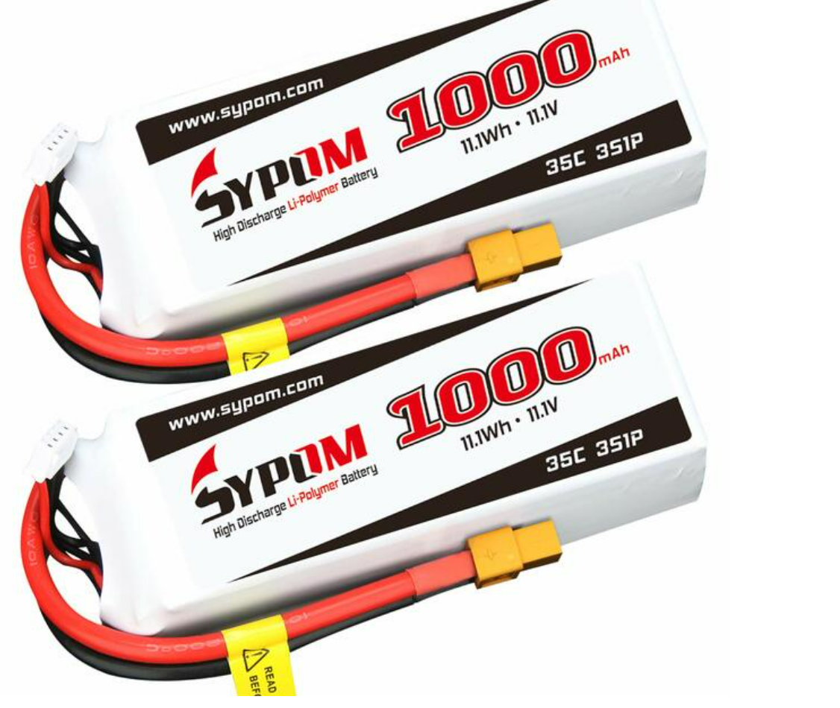
BATTERY
11.1 V Li-Po battery
Battery Capacity: 1000mAh
Quickly Rechargeable, long cycle life

Slide 14

SOFTWARE
PIXY CODE FOR OBJECT POSITION DETECTION
PWM FOR MOTOR CONTROL

Slide 15
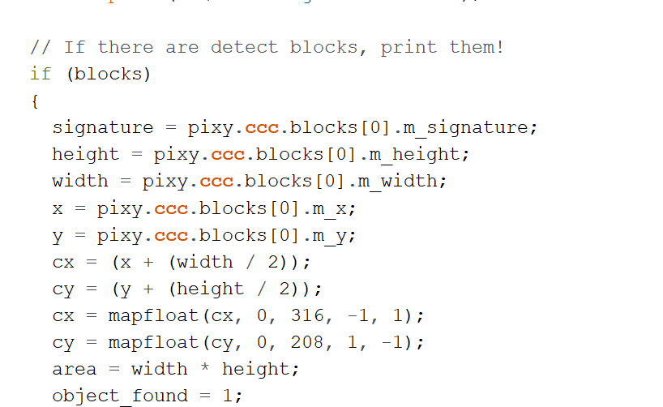
PIXY CODE
pixy.ccc.getBlocks() function can be used to read the blocks , if an object is detected .
This gives us x, y coordinates of the object , as well as width and height
Centre of the object is determined using cx = (x + (width / 2))
X range (0-316) and Y range(0-208) are mapped to -1 to +1
Object is on ground , so we only need Centre calculated with X
This is used to track left and right motion of the object.

Slide 16
Pwm (Pulse Width Modulation) for motor control
PWM is a technique in which the average value of the input voltage is adjusted by sending a series of ON-OFF pulses.
Average voltage is proportional to the width of the pulses, which is referred to as the Duty Cycle: Increased duty cycle , gives greater speed and vice versa.
When the motor is moving straight , both wheels are at duty cycle 70 (70/255= 27.5%)
When the motor is moving right , right wheels are at 40(15.6%) duty and left wheels are at 100 (39.2%) duty.
When the motor is moving left , left wheels are at 40(15.6%) duty and right wheels are at 100 (39.2%) duty.

Slide 17
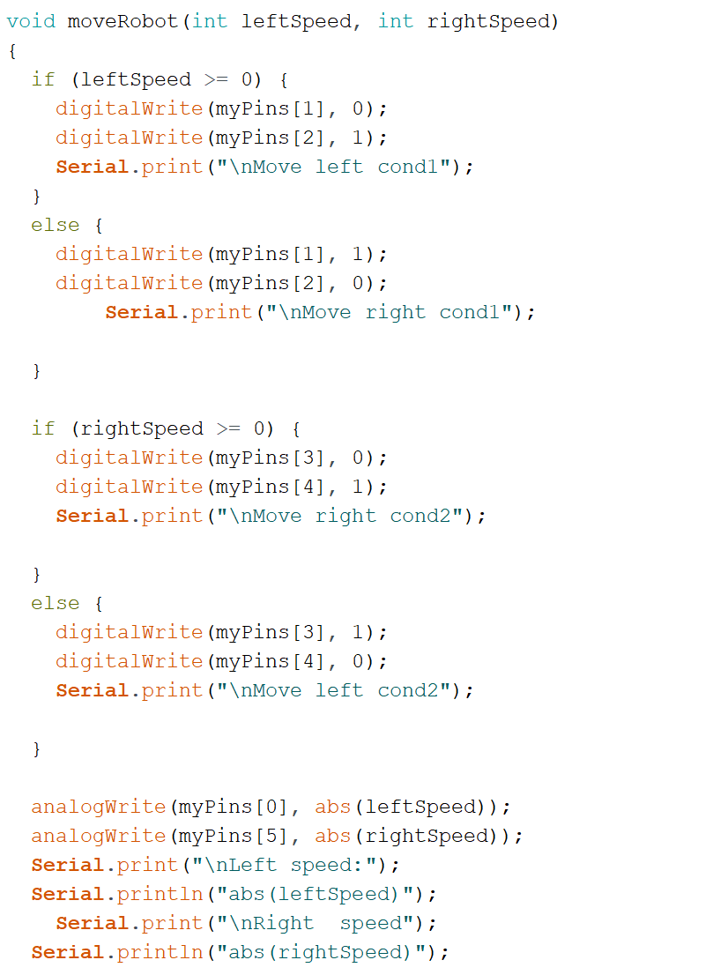
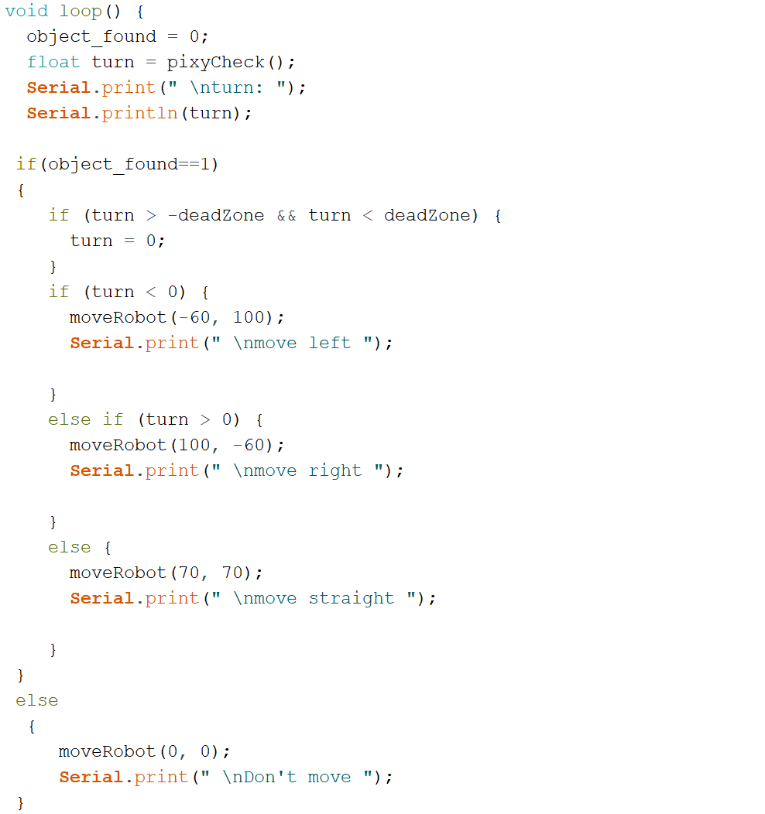
Motor code

Slide 18
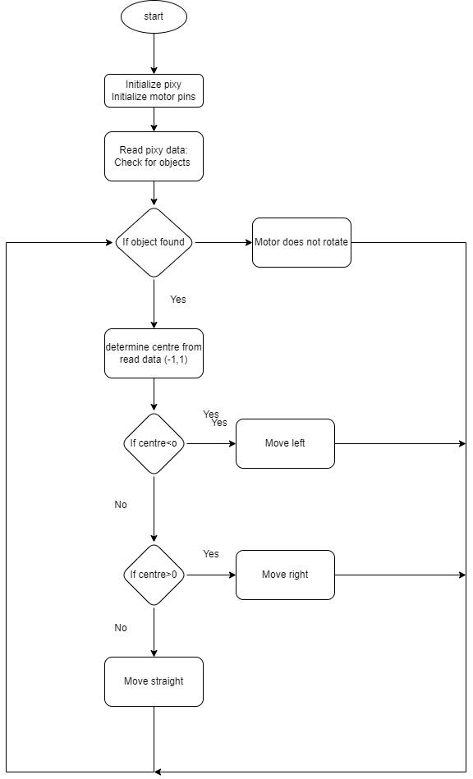
flowchart

Slide 19
BLOCK DIAGRAM
PIXY 2 CAMERA SENSOR
ARDUINO UNO
MOTOR CHASSIS
POWER-11V
LI-PO BATTERY

Slide 20
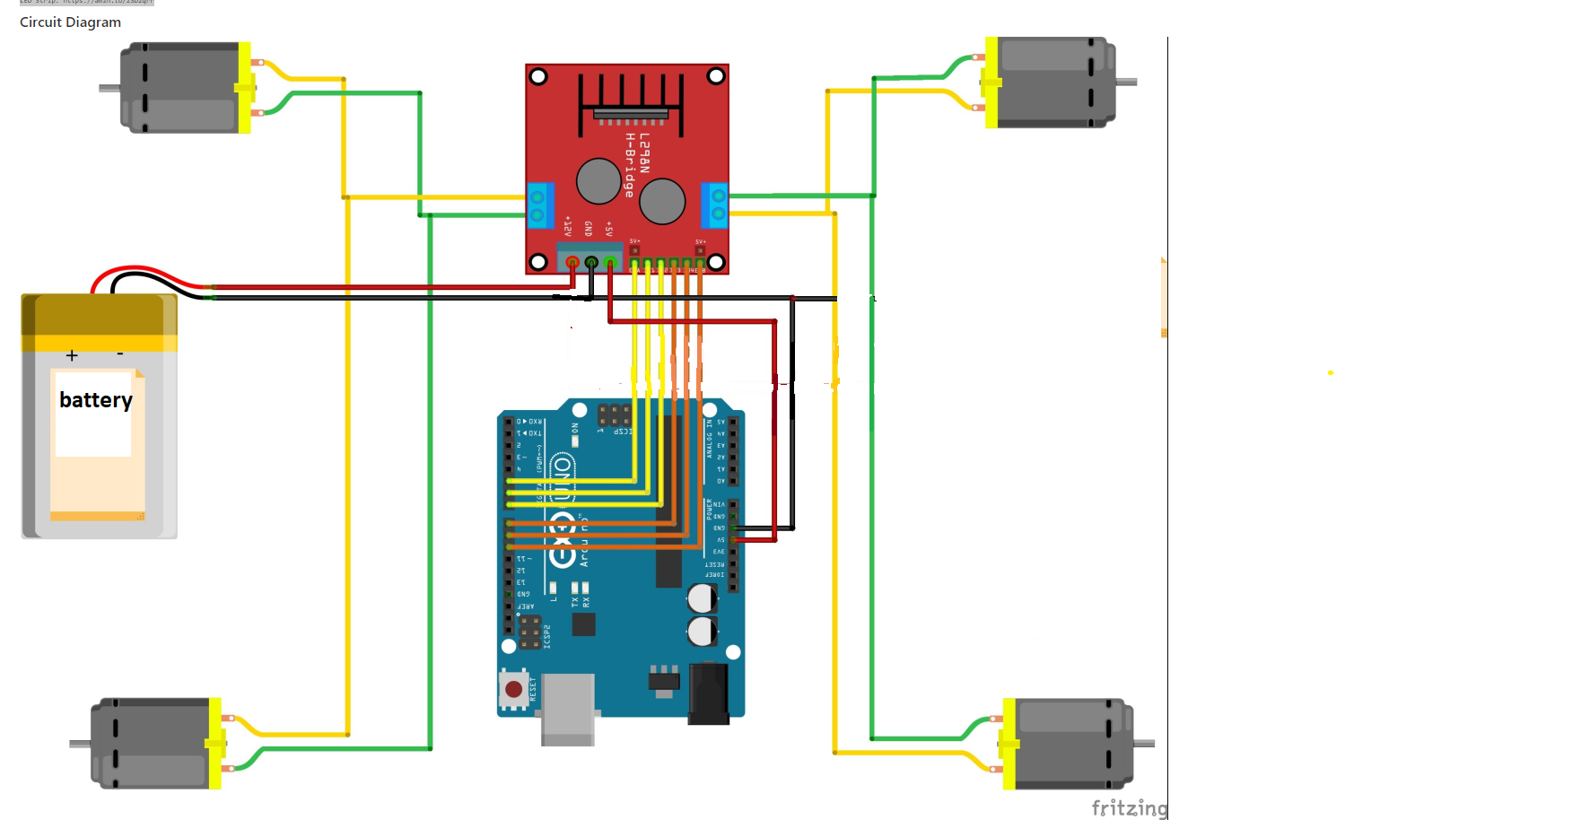
Circuit diagram

Slide 21
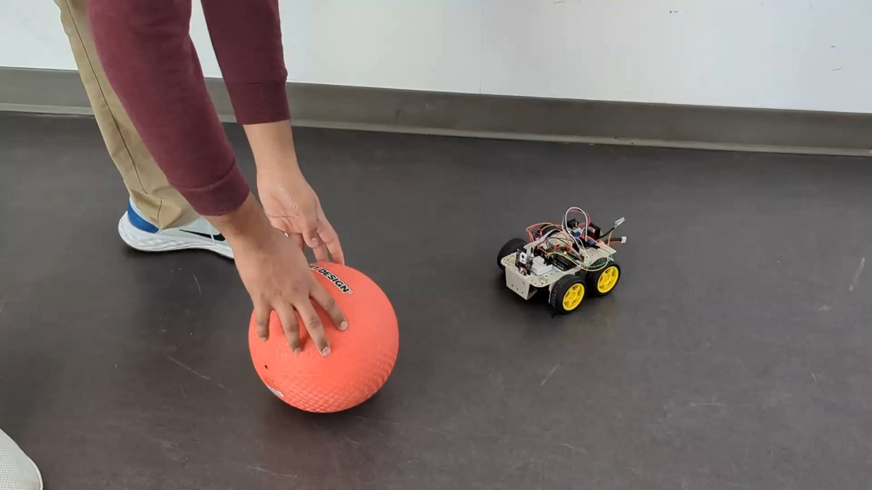
Demo

Slide 22
observations
Light does affect pixy2’s tracking ability , even in the same environment
The motor’s response varies based on external factors like the surface on which it is running.
Do not use the SPI pins (10, 11,12,13) for any I/O or PWM functions , as PIXY uses them to communicate with Arduino.

Slide 23
References
https://www.youtube.com/watch?v=w_krOCBk1DE
https://www.computervision.zone/courses/object-following-robot-with-arduino/

Slide 24

Thank you

